Slide 1
Interactive Movie Guide App
Group Name: Uncrushable Coders
Presented By:
Anitha 3BR22EC009
H.K.Sindhu 3BR22EC048
Anusha.C.M 3BR22EC013
Renuka 3BR22EC133

Slide 2
Problem Statement
Users struggle to find movies that match their preferences among the vast options available on streaming platforms.
Existing movie guide apps lack interactivity, personalization, and seamless integration with streaming services, leading to a disjointed and inefficient movie-watching experience.

Slide 3
Introduction
An interactive movie guide app is like having a personal movie expert in your pocket.
It offers comprehensive information about movies, including plot summaries, cast details, reviews, and ratings.
But what makes it truly interactive is its ability to tailor recommendations based on your preferences.
Whether you're in the mood for action, romance, or comedy, the app suggests movies that match your tastes.
Overall, it's a user-friendly tool designed to make choosing what to watch a breeze.

Slide 4
Module Description
Classes:
There are two classes defined: Movie and MovieDatabase. Movie is an abstract base class (ABC) with an abstract method display_info(). MovieDatabase is a class that manages a collection of movies and implements methods for adding, displaying, updating, and deleting movies, as well as for conducting a movie quiz.
Methods:
add_movie(): Prompts the user to input details of a movie and adds it to the movie database.
display_movies(): Displays all movies currently stored in the database.
update_movie(): Allows the user to update information about a specific movie.
delete_movie(): Allows the user to delete a movie from the database.
take_quiz(): Conducts a movie quiz by asking predefined questions and evaluating user responses.

Slide 5
Attributes:
movies: A dictionary storing movie titles as keys and their corresponding details (director, year, genre) as values.
score: Tracks the score of the user during the quiz.
quiz_questions: A dictionary containing quiz questions as keys and their corresponding answers as values.
Flow:
The program runs in an infinite loop, allowing the user to perform various actions. Based on user input, different methods of the MovieDatabase class are executed. The program terminates when the user chooses to exit.
Interactivity: The program provides a user-friendly interface, allowing users to interactively manage the movie database by adding, updating, and deleting movies, as well as taking a quiz.

Slide 6
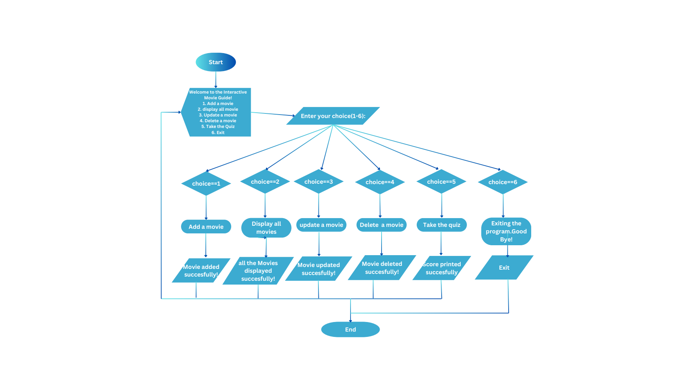
Flow Chart

Slide 7
Output
Welcome to the Interactive Movie Guide!
1. Add a movie
2. display all movie
3. Update a movie
4. Delete a movie
5. Take the Quiz
6. Exit
Enter your choice (1-6): 1
Enter the movie title: kgf
Enter the director's name: Prashant
Enter the release year: 2018
Enter the genre: action
kgf added to the movie database
Welcome to the Interactive Movie Guide!
1. Add a movie
2. display all movie
3. Update a movie
4. Delete a movie
5. Take the Quiz
6. Exit
Enter your choice (1-6): 1
Enter the movie title: kantara
Enter the director's name: Rishab
Enter the release year: 2022
Enter the genre: action thriller
kantara added to the movie database

Slide 8
Welcome to the Interactive Movie Guide!
1. Add a movie
2. display all movie
3. Update a movie
4. Delete a movie
5. Take the Quiz
6. Exit
Enter your choice (1-6): 2
Movie database:
Title : kgf , Director : Prashant , Year: 2018, Genre: action
Title: kantara , Director: Rishab , Year: 2022, Genre: action thriller
Welcome to the Interactive Movie Guide!
1. Add a movie
2. display all movie
3. Update a movie
4. Delete a movie
5. Take the Quiz
6. Exit
Enter your choice (1-6): 3
Enter the title of the movie you want to update: kgf
Enter new information (leave blank to keep current value):Director (prashant):
Year (2018): 2019
Genre (action):
kgf updated in the movie database.

Slide 9
Welcome to the Interactive Movie Guide!
1. Add a movie
2. display all movie
3. Update a movie
4. Delete a movie
5. Take the Quiz
6. Exit
Enter your choice (1-6): 2
Movie database:
Title: kgf , Director : Prashant , Year: 2019, Genre: action
Title: kantara , Director: Rishab , Year: 2022, Genre: action thriller
Welcome to the Interactive Movie Guide!
1. Add a movie
2. display all movie
3. Update a movie
4. Delete a movie
5. Take the Quiz
6. Exit
Enter your choice (1-6): 4
Enter the title of the movie you want to delete: kantara
kantara deleted from the movie database.

Slide 10
Welcome to the Interactive Movie Guide!
1. Add a movie
2. display all movie
3. Update a movie
4. Delete a movie
5. Take the Quiz
6. Exit
Enter your choice (1-6): 2
Movie database:
Title: kgf, Director: prashant, Year: 2019, Genre: action
Welcome to the Interactive Movie Guide!
1. Add a movie
2. display all movie
3. Update a movie
4. Delete a movie
5. Take the Quiz
6. Exit
Enter your choice (1-6): 5
Welcome to the Movie Quiz!
What year was the movie 'KGF' released? 2018 Correct!
Who directed the movie 'Kantara'? Rishab Incorrect!.
What is the genre of the kgf movie ? Action Correct!
You scored 2 out of 3.

Slide 11
Welcome to the Interactive Movie Guide!
1. Add a movie
2. display all movie
3. Update a movie
4. Delete a movie
5. Take the Quiz
6. Exit
Enter your choice (1-6): 6
Exiting the program.
Goodbye! Process finished with exit code 0

Slide 12
Challenges
Uploading this code might face challenges like ensuring stable internet for file transfer, managing versions using Git, conducting thorough code reviews, documenting functionality, testing for reliability, ensuring security measures, and integrating with existing systems.

Slide 13
Conclusion
The code creates an interactive movie database system in Python. It lets users add, display, update, or delete movies, and also take a movie quiz. It's built using classes, methods, and a menu-driven interface.

Slide 14


